Slide 1

Exploring IllustrisTNG simulations to derive observationally comparable star formation rates (and metallicities?)
TNG_workshop.py
title.info
www.tng-project.org
< Bryanne McDonough & Olivia Curtis >
Request API key ->
Notes:
This workshop was initially developed for the Spring 2024 STScI symposium on ‘Recipes for Star Formation.’ This workshop was delivered by Bryanne McDonough, and the accompanying Jupyter notebooks were co-developed with Olivia Curtis. There are three notebooks in total. The first notebook will require that you request an API key to download data directly from the TNG website. If you just want to get some practice working with simulation data, the Github repository includes the data files that would have been created in the first notebook. If you do not want to request an API key, we still recommend reviewing the content of the first notebook before attempting the other two.
Comments were added to these slides to assist users who did not attend the symposium.

Slide 2
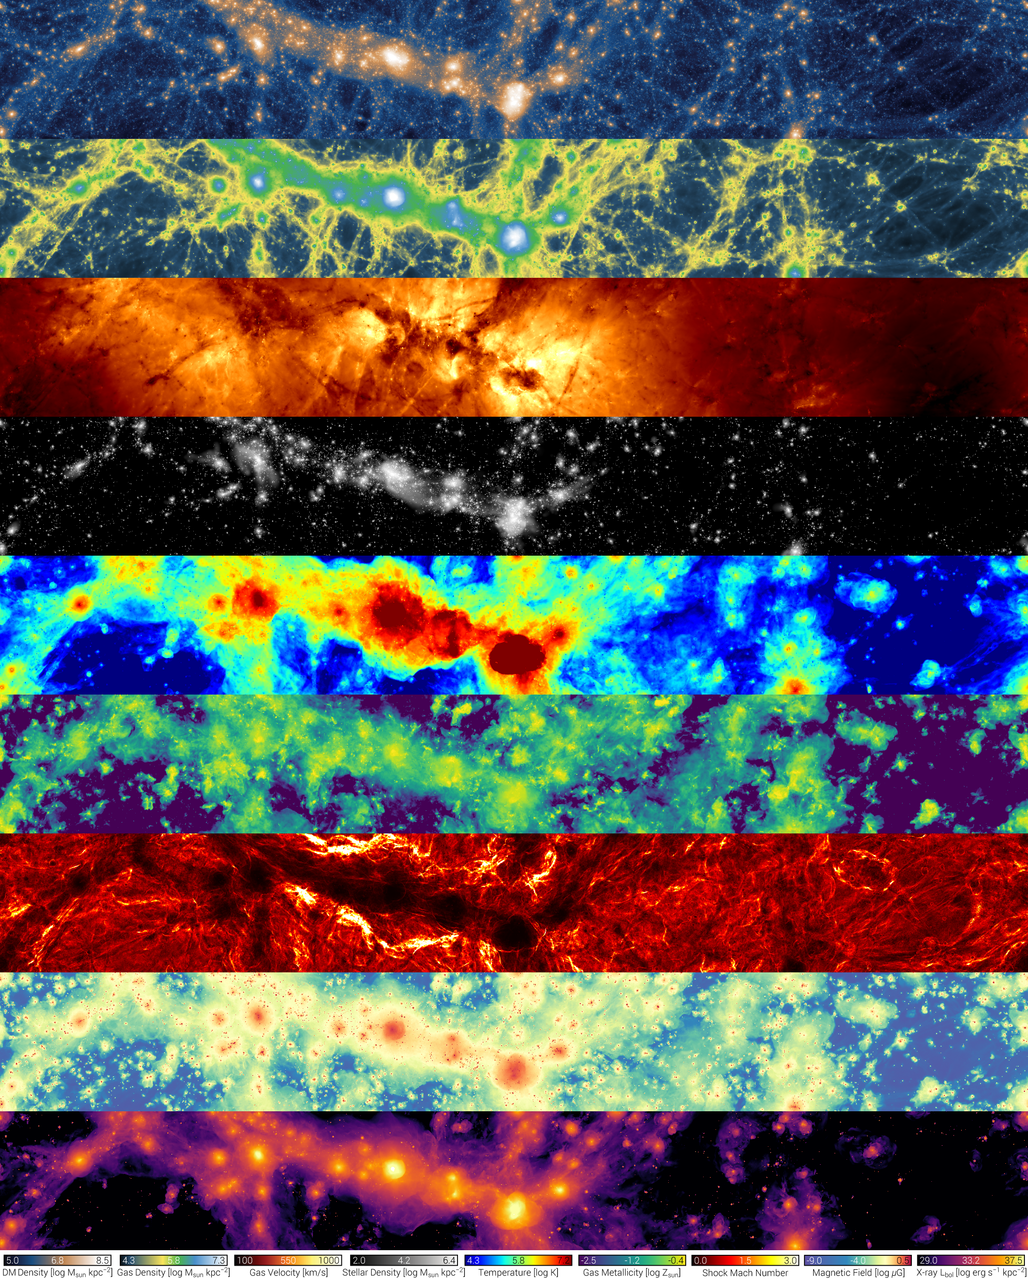
Dark matter column density
Gas column density
Gas velocity
Stellar column density
Temperature
Gas metallicity
Shock Mach number
Magnetic field
X-ray luminosity
Notes:
This graphic shows a cross-section from the TNG100 simulation and gives select examples of the types of output that can be obtained from the TNG simulations.

Slide 3
Learning goals {
TNG_workshop.py
Learning_goals.info
Understand the scope and purpose of the Illustris TNG simulation suite, including available simulations, observational tensions, and limitations to the simulation.
Navigate and interpret essential TNG data products, such as Halo/Subhalo catalogs, supplementary catalogs, merger trees, and particle data.
Learn to access and manipulate TNG data using the TNG API, through both browser-based exploration tools and Python API requests.
Derive observationally comparable parameters relating to star formation from TNG galaxies, including calculating global and star formation rates and determining luminosity-weighted ages.
Gain practical skills in translating simulation data into meaningful astrophysical insights.
Apply acquired knowledge and skills to conduct research using Illustris TNG data.
}
Notes:
The learning objectives for this workshop and the tutorial notebooks.

Slide 4
Table Of ‘Contents’ {
01
02
03
TNG_workshop.py
contents.info
About IllustrisTNG
< Suite of magnetohydrodynamic cosmological simulations >
Data Specifications
< Distinguish the different types of data available >
Practical Exercise
< Your turn! Practice in Jupyter Notebooks >
}

Slide 5
01 {
[About IllustrisTNG]
TNG_workshop.py
about_IllustrisTNG.info
< Suite of magnetohydrodynamic cosmological simulations >
}
Notes:
More information regarding the IllustrisTNG (or just ‘TNG’) simulations can be found on their website: https://www.tng-project.org. I suggest reviewing the Project Description and Data Access pages, and the release papers under their Results section (as well as release papers for the predecessor simulation Illustris, and the documentation for the simulation framework AREPO).
‘Magnetohydrodynamic’ refers to the types of processes that are modeled by the simulation. ‘Cosmological’ refers to the large volume that is simulated, which is meant to simulate a ‘mini Universe’ that includes galaxies within their cosmological contexts (e.g., groups, clusters, cosmic voids).
Hydrodynamic processes (essentially, how cells of gas move and change) are more computationally expensive to model than gravitational forces alone. For that reason, early cosmological simulations were N-body only, meaning that they only modeled the gravitational forces between a number (N) of massive particles. Dark matter, the majority of the matter in our Universe, only interacts via gravity, so N-body simulations were able to successfully capture the distribution of matter in our Universe and test the impact of adopting different cosmological models.
The inclusion of hydrodynamics becomes important when considering processes like gas accretion, winds, star formation, metallicity content, and much more. Gravitational forces and dark matter particles are still included, but hydro sims will also include star particles, black hole particles, and gas cells. Star particles are formed out gas cells according to prescriptions that will be discussed later. In the case of the TNG sims, (supermassive) black hole particles are seeded into halos (i.e., galaxies) once they meet certain criteria.
In the update between Illustris and IllustrisTNG, seed magnetic fields were attached to the gas cells, and the magnetic terms of the hydrodynamic equations were included in the hydro calculations.

Slide 6
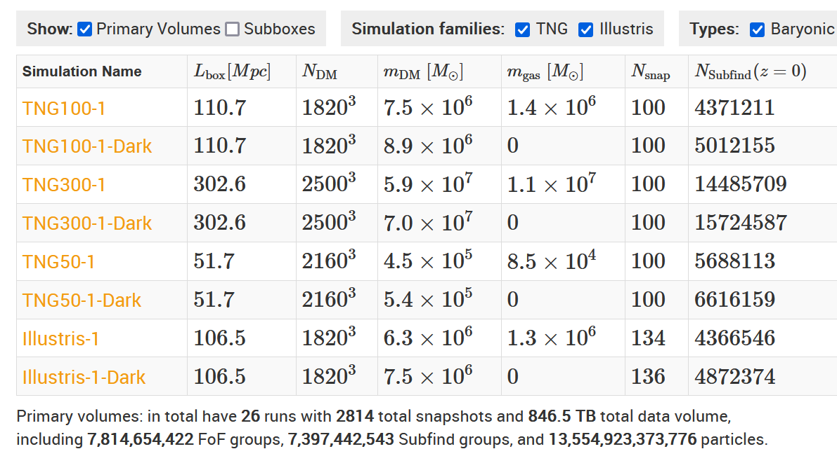
Available Simulations; {
TNG_workshop.py
about_IllustrisTNG.info
}
Notes:
IllustrisTNG is a suite of simulations with varying resolutions and volumes. Simulators must trade off between volume and resolution when constructing simulations, because both increase the computational demands of the project. The image above includes the three main TNG simulations (TNG100-1, TNG300-1, and TNG50-1), as well as the Illustris-1 simulation. Each of the three main simulations are accompanied by two simulations that use the same model and conditions but are simulated at coarser resolutions (e.g., TNG100-2, TNG100-3, which are not shown above). These coarser simulations enables users to test the resolution-dependence of their results. Each simulation is also accompanied by a ‘Dark’ simulation which only includes dark matter particles and gravity, which can be used for a variety of tests which look at the effect of including hydrodynamic/baryonic processes.
Each simulation is a cube with periodic boundary conditions (meaning if a galaxy’s motion takes it out of one side of the box it will appear on the opposite side with the same properties). The box lengths are given in the second column of the above table. The simulation identifier corresponds to the rounded box length (e.g., TNG100 has a box length of 110.7 Mpc, so roughly 100 Mpc). N_DM gives the number of dark matter particles included in the simulation, while m_DM gives the mass of each dark matter particle (the ‘mass resolution’). The fifth column, m_gas gives the target mass of the gas cells. N_snap is the number of ‘snapshots’ provided of the simulation, which each correspond to a specific redshift. Lastly, N_subfind is the number of subhalos (galaxies) identified in the final snapshot (z=0).
The TNG simulations share much of the same framework as Illustris-1, and TNG100-1 uses the same initial conditions, volume, and resolution. The main difference between these two simulations is the implementation of AGN feedback in the high-accretion mode (which is discussed in the next slide). The distribution of star formation (and, thus, colors) among galaxies in the Illustris simulation did not reproduce the distributions of star formation and colors measured from observed galaxies. If using the Illustris simulation, care should be taken to consider how the AGN feedback and resulting poor agreement between the simulation and observation should be considered.

Slide 7
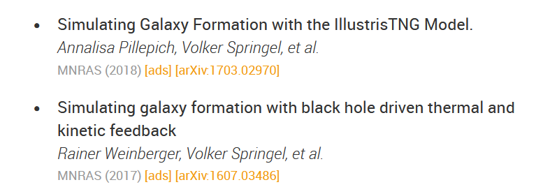
SF and AGN Feedback modeling
TNG_workshop.py
about_IllustrisTNG.info
# Stars form stochastically in gas cells above a density threshold of 0.13 cm⁻³
# Model includes gas cooling, stellar evolution, gas recycling, chemical enrichment, SNe-driven kinetic stellar feedback
# SMBH: seeding, accretion, merging, feedback
AGN Feedback
High-Accretion
“Quasar Mode”
Low-Accretion
“Kinetic Mode”
Thermal energy injected into surrounding gas
Kinetic energy injected into surrounding gas
← methods papers
Notes:
Refer to the methods papers and references therein for a complete description of the models: http://ui.adsabs.harvard.edu/abs/arXiv:1607.03486, http://ui.adsabs.harvard.edu/abs/arXiv:1703.02970. Here, I provide a simplified overview.
The simulation begins with only dark matter particles and gas cells (tracked by ‘tracer particles’). Once the gas cells reach a given density threshold (0.13 cm⁻³), they will form stellar particles stochastically. The mass and metallicity of the stellar particle is dependent on the conditions of its parent gas cell. The minimum mass of a stellar particle is given by the target baryon mass of the simulation, and a single stellar particle represents a population of stars all formed at the same time. Each stellar particle tracks a number of parameters, including birth position, initial mass, present mass, formation time, luminosity, and more. The stellar particle inherits its metallicity from the parent gas cell. As the simulation evolves, the stellar particle can account for stellar evolution and feedback by adjusting in luminosity and mass, chemically enriching surrounding gas cells, and launching ‘wind’ particles.
If a halo reaches a set halo mass (5 × 10¹⁰ h⁻¹ M⊙) and does not already contain a black hole (BH) particle, one with M_{BH} = 8 × 10⁵h⁻¹M⊙ will be seeded at the center of the gravitational potential. The BH particles will grow in mass through mergers (which occur whenever two BH cells encounter each other) or through accretion. There are two accretion modes, the high-accretion ‘quasar’ or ‘thermal’ mode where the accretion rate is set by the Bondi-Hoyle-Lyttleton rate (Mdot_{Bondi}) or the low-accretion ‘kinetic’ mode where accretion is set by the Eddington accretion rate (Mdot_{Edd}). The BH grows in mass (which is subtracted from the surrounding gas cells) at the Eddington-limited Bondi accretion rate. The high- or low- accretion rate mode determines how feedback is injected into the surrounding galaxy. The cross-over between the two modes occurs when the Eddington ratio (Mdot_{Bondi}/Mdot_{Edd}) exceeds a BH-mass dependent threshold. In the low-accretion mode, kinetic energy is injected into the surrounding gas cells, producing a sort of wind. In the high-accretion rate mode, surrounding gas cells are injected with thermal energy.
The main difference between the TNG simulations and the Illustris simulations is how the high-accretion mode works. In Illustris, the feedback energy was injected into the galaxy’s halo, far from the (central, supermassive) BH. This was intended to mimic the effect of AGN jets but resulted in several discrepancies between observed galaxies and those simulated with Illustris.

Slide 8
Calibration and Validation
TNG_workshop.py
about_IllustrisTNG.info
Calibration:
# reproduce observed galaxy properties at z=0, including:
# galaxy stellar mass function and stellar-to-halo mass relation
# total gas mass content within virial radius of massive groups
# stellar mass – stellar size and BH – galaxy mass relation
# at z<10, the shape of cosmic SFR density
Validation:
# comparable to observations in several regimes not tuned to, incl:
# radial distribution of SF properties
# galaxy populations, galactic structural and stellar population properties
# red sequence and blue cloud of galaxies (Nelson+ 2018a)
# galaxy stellar mass functions up to z∼4 (Pillepich+ 2018b)
# population of quenched galaxies both at low (Weinberger+ 2018) and high redshift (Hazouhit+ 2018)
Public Data Access Overview / Background and Important Details
Notes:
Simulators must choose several aspects with which to calibrate free parameters in the physical models used by the simulation. Those aspects cannot be used as a test of the simulation’s accuracy, because parameters in the simulation were specifically chosen to result in those aspects. Some of these aspects are discussed on this slide, for more information see https://www.tng-project.org/data/docs/background/#sec3. This section also discusses some of the validation tests that were done, meaning that the simulation accurately reproduced observations in those respects. A key success of the TNG models was the reproduction of the distribution of galaxy colors at z=0, which was not reproduced with the original Illustris model.

Slide 9
Cautions
TNG_workshop.py
about_IllustrisTNG.info
Need to balance desire for large sample size with necessary spatial resolution
Minimum spatial resolution set by gravitational softening radius
Comparison with observations requires careful consideration
Some possible tensions with observations listed in background information
Notes:
Several cautions must be kept in mind when working with simulated data:
We have already discussed how the need for a large sample must be balanced with the desire for high spatial resolution.
Due to the high mass of simulated particles, the force of gravity between two particles can approach infinity if the distance between those particles becomes small. Thus, simulations impose a ‘gravitational softening radius.’ If the distance between two particles becomes smaller than that radius, the force of gravity is modified such that it can not approach infinity. Physics below that radius are thus not resolved. The minimum spatial resolution researchers should consider is several times the softening radius. Other factors with which to consider when determining if a simulation is resolved is the minimum particle masses and number of particles contained in a galaxy, depending on your use case.
When comparing results of simulations to observations, consideration must be given regarding how measurements are made in observations versus how measurements are made in simulations. For example, the absolute magnitudes of galaxies given in the SubFind group catalogs (which will be discussed in the next section) do not take into account reddening by dust. Thus, I would recommend using the ‘SDSS ugriz and UVJ Photometry/Colors with Dust’ supplementary catalog when comparing results that use magnitudes. Another example is that the star formation rates (SFRs) for galaxies in the group catalogs only consider the instantaneous SFR, while observational tracers of star formation rate depend on the presence of young stars, which were formed tens-to-hundreds of Myrs ago.
Several tensions with observations have been identified. Here are some specific cautions listed on the TNG web page:
TNG galaxies may have a weaker connection between galaxy morphology and color than observed at z∼0, reflected in a possible excess of red disk-like galaxies in the simulations (Rodriguez-Gomez+ 2018, although see Tacchella+ 2019)
TNG galaxies exhibit a somewhat sharper trend than observations in quenched fraction vs. galaxy stellar mass for M⋆∈10¹⁰⁻¹¹M⊙ (Donnari+ 2019 and Donnari+ 2020b), and similarly in the relation between sSFR and M_{BH} at low redshift (Terrazas+ 2020).
locus of the galaxy star-forming main sequence is below the face-value observed SFMS at 1≲z≲2, modulo known inconsistencies with e.g. the observed stellar mass function (Donnari+ 2019a).
H2 mass content of massive TNG galaxies at z=1−3 may be lower than implied by ALMA observations (Popping+ 2019) and sub-mm galaxy demographics (Hayward+ 2020).
Starbursting galaxies are also not well-reproduced by TNG, likely because it lacks the spatial resolution necessary to model gas flows to the center of galaxies during mergers. (See Sparre & Springel 2015, McDonough et al., 2023).
Lastly, simulations do not necessarily represent reality. They implement a number of physical models drawn from various astrophysical subfields and simulations must make a number of assumptions regarding physical processes that cannot be directly modeled because they occur on scales smaller than the simulation resolution.

Slide 10
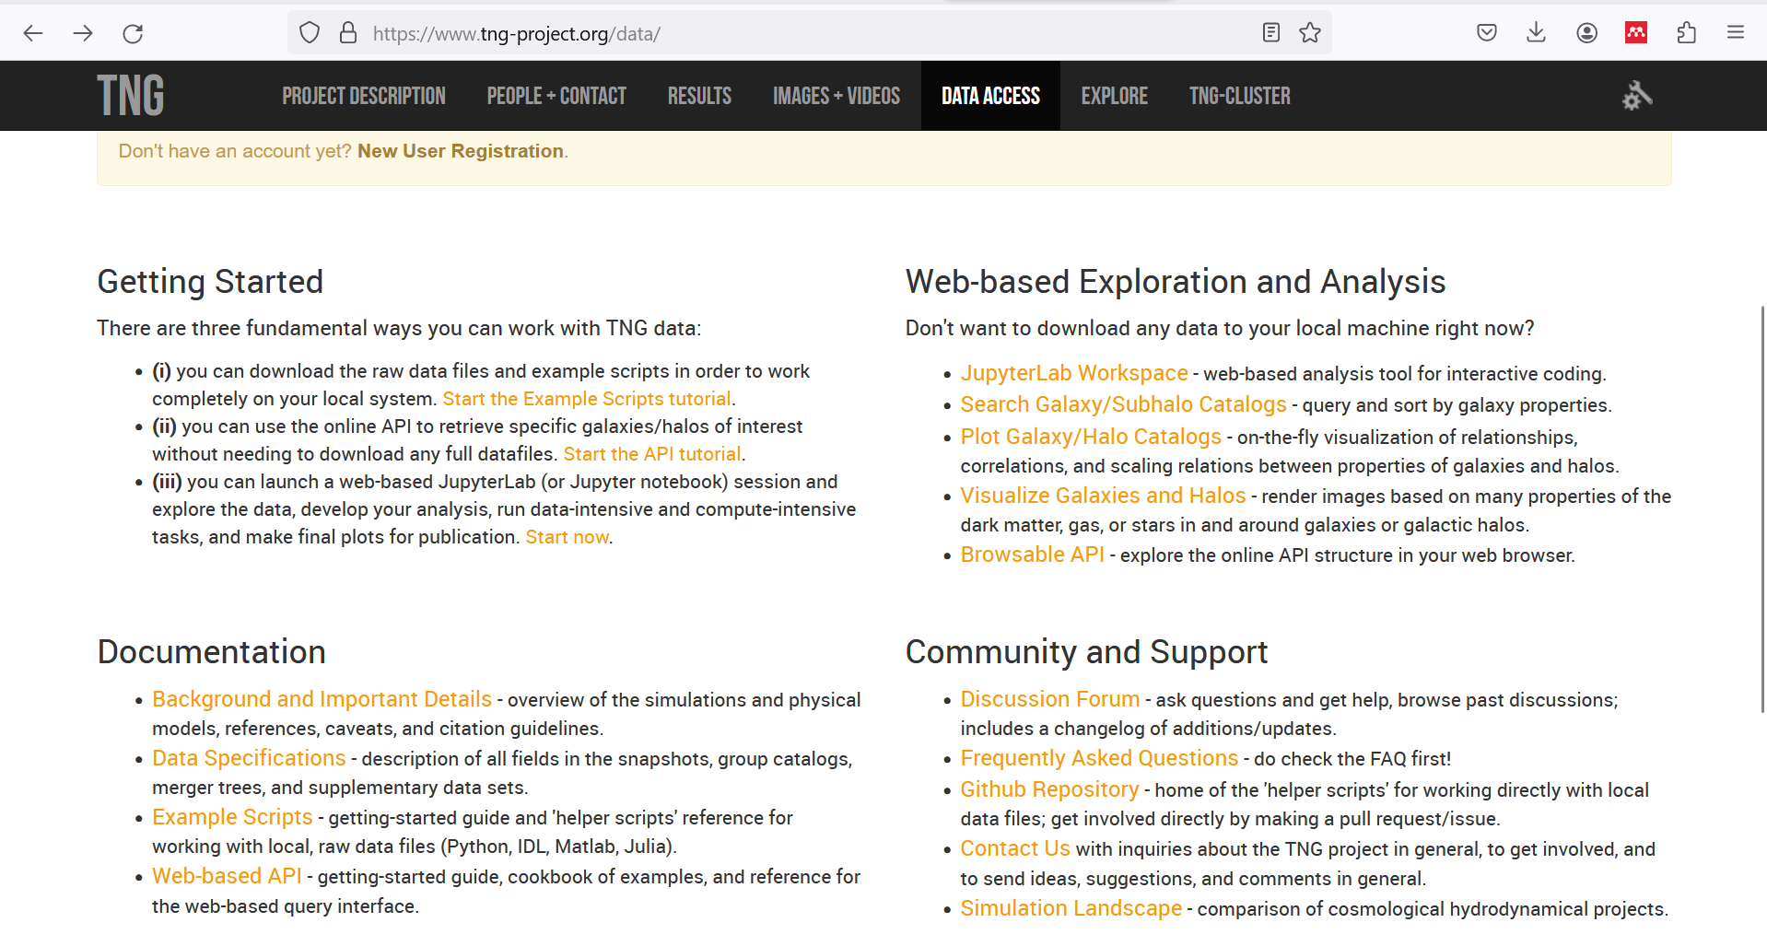
What Is this ‘Topic About ?’ {
forbeginners.html
workshop.css
Languages
Html
60%
Css
40%
< Mercury is the smallest planet in the entire Solar System >
< The Earth is the only one that harbors life in the Solar System >
Create a web page
Venus has a nice name
Mars is a cold place
Jupiter is a gas giant
}
Programming Language
Notes:
This slide shows a screenshot of the TNG ‘Data Access’ page, which contains links to many helpful sources for working with TNG data: https://www.tng-project.org/data/
Both the ‘example scripts’ and ‘web-based API’ guides provide many examples for working with TNG data and downloading subsets of data with the API. ‘Background and Important Details’ includes an overview of the simulations, including parameters for the different simulations, scientific cautions, and citation guidelines. ‘Data Specifications’ is one of the most helpful pages if you regularly work with TNG data. It includes descriptions of all the data types available, the fields available for each particle, galaxy, and halo (including units), a description of the merger trees, and an ever-growing set of supplementary catalogs derived by TNG users.
The Web-based Exploration and Analysis tools can provide easy tools for exploring the data. The galaxy/subhalo search enables querying of the galaxy properties that are included in the ‘subfind’ catalog. Relationships between parameters can be explored with the ‘Plot Galaxy/Halo Catalogs’ tool. The ‘Visualize Galaxies and Halos’ tool can be used to visualize many of the particle parameters for both galaxies and halos – also note the ‘I'm really in love with this halo/subhalo! Show me everything about it’ link at the bottom of visualizations, which will visualize many parameters at once. The Browsable API tool can be useful when trying to understand the data structure of the simulation. It’s also helpful when trying to debug your API calls.
The Discussion Forum is a resource to discuss issues with the TNG team and other users. The FAQ contains other information that may be of use, and the Github Repository includes scripts in several languages for downloading the simulation data with the API.
If you want to learn more about how TNG compares to other simulations, check out the ‘Simulation Landscape’ page.

Slide 11
02 {
[Data Specifications]
TNG_workshop.py
data_specifications.info
< Distinguish the different types of data available >
}
Notes:
Rarely will an individual user need to download the entire simulation data set (TNG100-1 has 73 TB of data in total). In this section, I will discuss the variety of data products available from the simulation and how the API can be used to download only what you need to work with. Users who need to work with a large portion of the simulation data should reach out the TNG team, as there are options to work on their servers.

Slide 12
Data Types {
TNG_workshop.py
data_specifications.info
group catalogs:
Halo (FoF group) and subhalo (galaxy) properties
snapshots:
Particle-level data
merger trees:
Track galaxy properties across snapshots
supplementary data catalogs:
Data derived by other users
}
Notes:
The first Jupyter Notebook describes how to use the API to access each of these data types, and explores the structure of them. In the next slides, I will describe each of these further.
The group catalogs, along with some supplementary data catalogs, provide a number of properties for simulated galaxies and halos at different redshifts.
As the simulation evolves in time, ‘snapshots’ of the particle data will be taken at specific redshifts. ‘Full’ snapshots contain data for every field of every particle in the simulation. Some snapshots only contain a subset of the particle fields; these are only partial snapshots.
Merger trees follow the properties of galaxies and halos between snapshots. They are named merger trees because subhalos/galaxies will merge together over time. The trees trace the properties of the most massive progenitors.

Slide 13
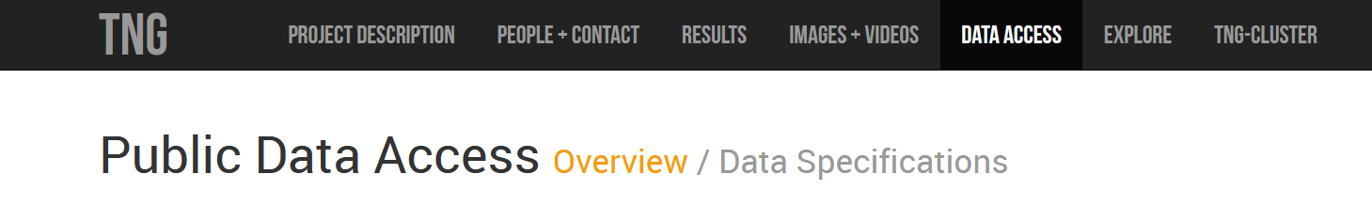
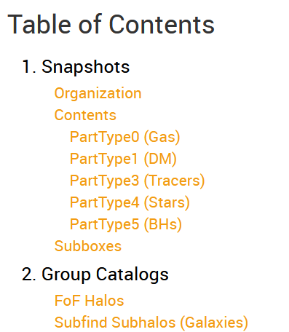
class group_catalogs:
TNG_workshop.py
data_specifications.info
# Halo (FoF group) and subhalo (galaxy) properties for each snapshot
Learn about available properties, units, etc:
Examples:
Notes:
There are two types of group catalogs:
The FoF Halos are halos identified by a friends-of-friends algorithm, which identifies all particles that exist within a given ‘linking length’ of each other. These halos are essentially galaxy groups and clusters. For example, a ‘Milky Way’ FoF group would include particles from the Milky Way, its satellites (including the large and small magellanic clouds), its circumgalactic medium, and its dark matter halo.
The Subfind Subhalos are identified with the Subfind algorithm, which identifies substructure within the FoF halos. Each subhalo is analogous to a galaxy (or dwarf galaxy).
The group catalogs include parameters aggregated over all particles in a halo or subhalo, including mass, size, absolute magnitude, SFR, and much more. In the Data Specifications, descriptions of how the parameters were computed from the particle data are given alongside the units.
Each field (parameter) in the group catalogs can be downloaded separately, and each row in the data is for a given halo/subhalo. When making subsamples of TNG data, it is important to keep track of the Halo or Subhalo ID for the halo or subhalo. This ID is just the index into the group catalog. Keeping track of these IDs will help you if you match galaxies back to their entries in the group catalogs, and to entries in some of the supplementary catalogs.
The slide above includes two examples of entries found in the subhalo catalog. It is important to pay attention to the description of the parameter to understand how it was measured.
Not shown above, an important parameter to pay attention to is the ‘subhalo flag.’ If this binary parameter is 0, it should generally be excluded from analysis, since it is not cosmological in origin.

Slide 14
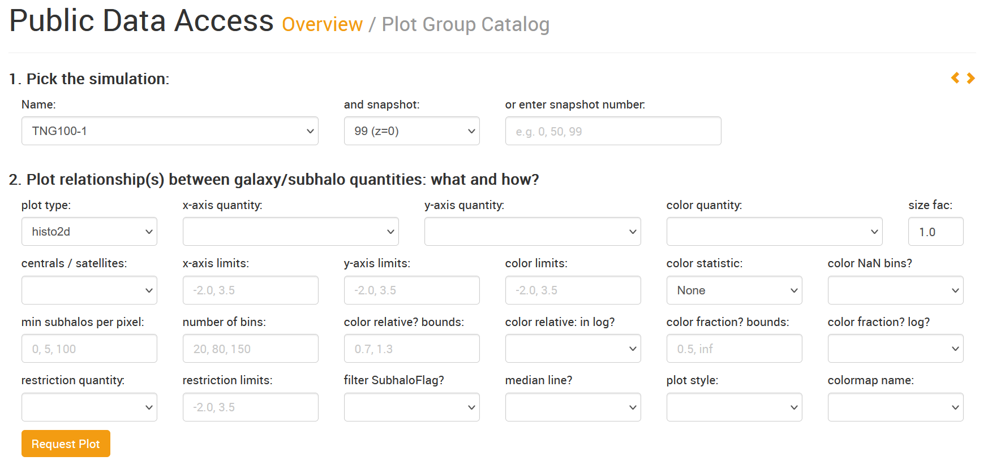
class group_catalogs:
TNG_workshop.py
data_specifications.info
def group_vis_tool():
Notes:
Relationships between parameters in the group catalogs can be plotted on the TNG website using the ‘Plot Group Catalog’ tool.

Slide 15
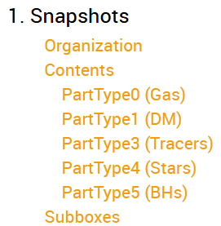
class snapshots:
TNG_workshop.py
data_specifications.info
# A full snapshot includes all particle data at a given timestep
# These files can be LARGE, but you’ll rarely need every field
# Instead, fetch only the particle parameters you want, and/or utilize cutouts
Learn about available properties, units, etc:
Cutouts = files that contain all particles bound to a halo/subhalo
Useful for:
Examining resolved properties/ profiles of galaxies/halos
Obtaining parameters not included in group catalogs
Notes:
As the simulation evolves, ‘snapshots’ of the particle data are taken at specified redshifts. Each snapshot includes all the particles with their positions and some other information, but only ‘full’ snapshots contain every field for every particle. There are also ‘subboxes’ which have better time resolution but contain only particles from a smaller volume. Particle-level data can be useful for obtaining parameters not included in the group catalogs or other exercises, like spatially resolved properties. Rarely will a user need to download a full snapshot, which are very large. For example, the z=0 snapshot of TNG100 is 1.7 TB.
There are two main options for downloading subsets of the particle data:
Download only specified fields of specified particles from a snapshot.
Download ‘cutouts’ which include all particles gravitationally bound to a halo or subhalo, for which you can also specify only certain particles and fields.
Care must be taken when using cutouts to compare to observations, as observations of a galaxy may include parts that are not ‘bound’. One workaround is to download the halo cutout for the subhalo of interest and select particles within a given aperture.

Slide 16
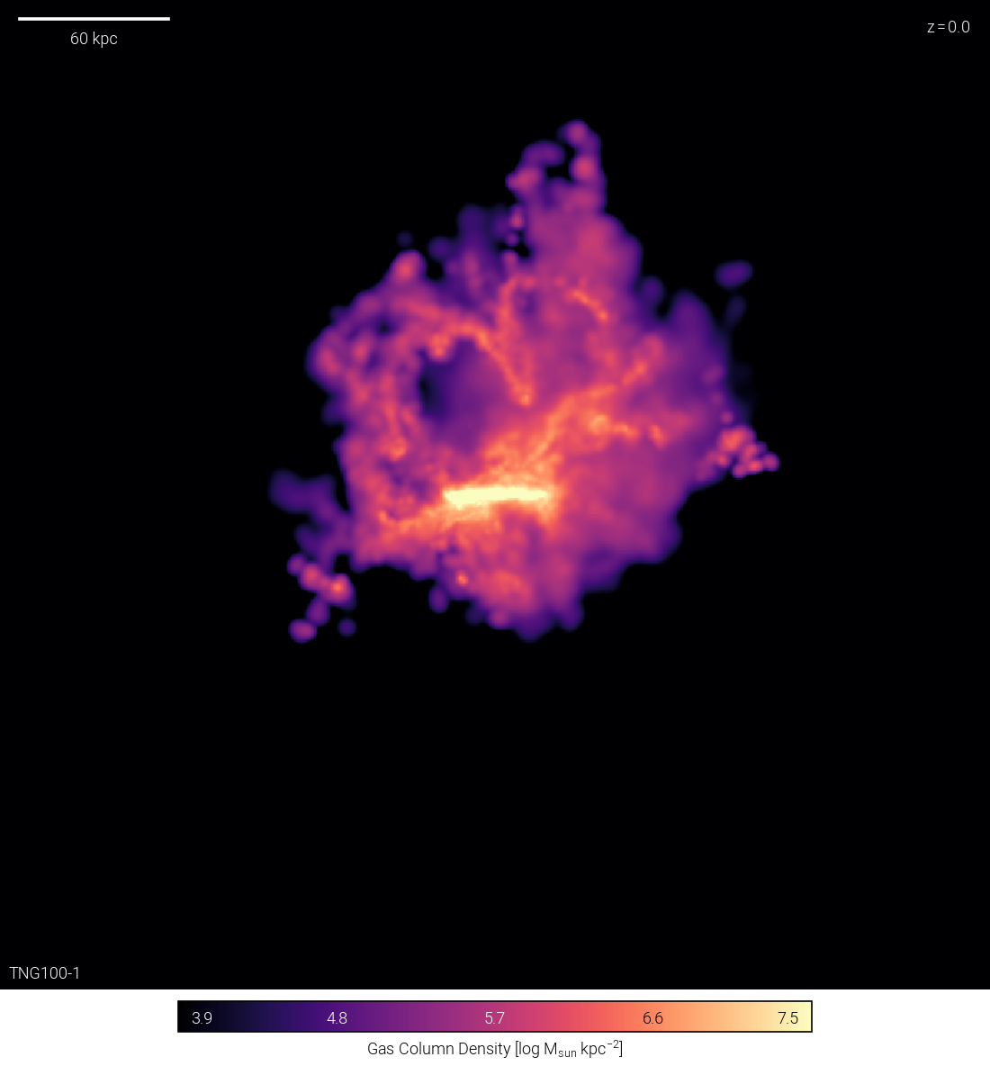
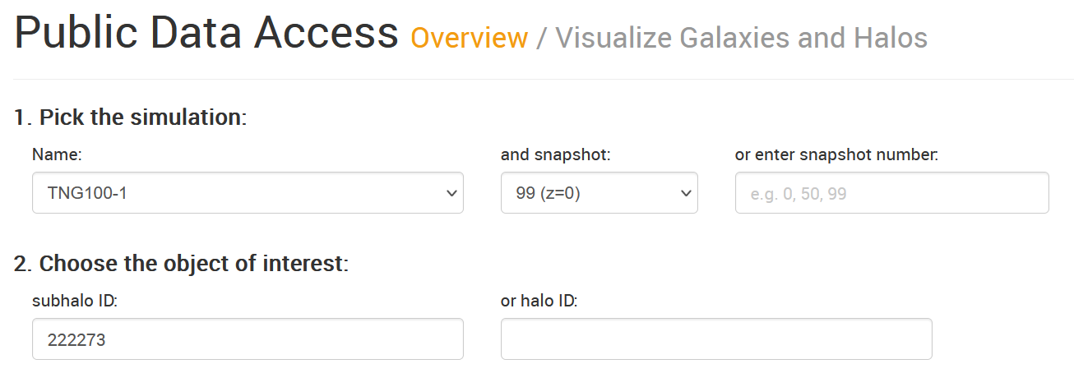
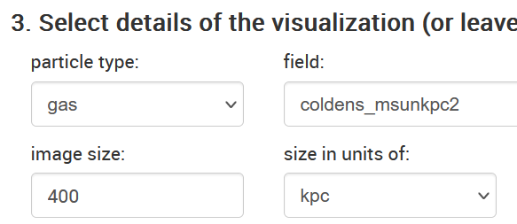
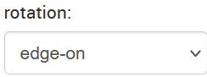
class snapshots:
TNG_workshop.py
data_specifications.info
def cutout_vis_tool():
Notes:
Particle-level data for subhalo or halo cutouts can be visualized with the ‘Visualize Galaxies and Halos’ tool. These publication-quality visualizations can be customized with a variety of parameters. On the slide is an edge-on visualization of the gas column density of subhalo 22273 in TNG100-1. The morphology of gas in this subhalo indicates that it recently underwent an interaction but note that the galaxy it interacted with will not be shown because those particles are not bound to this subhalo.
This can be a great tool for visually inspecting outliers in your data.

Slide 17
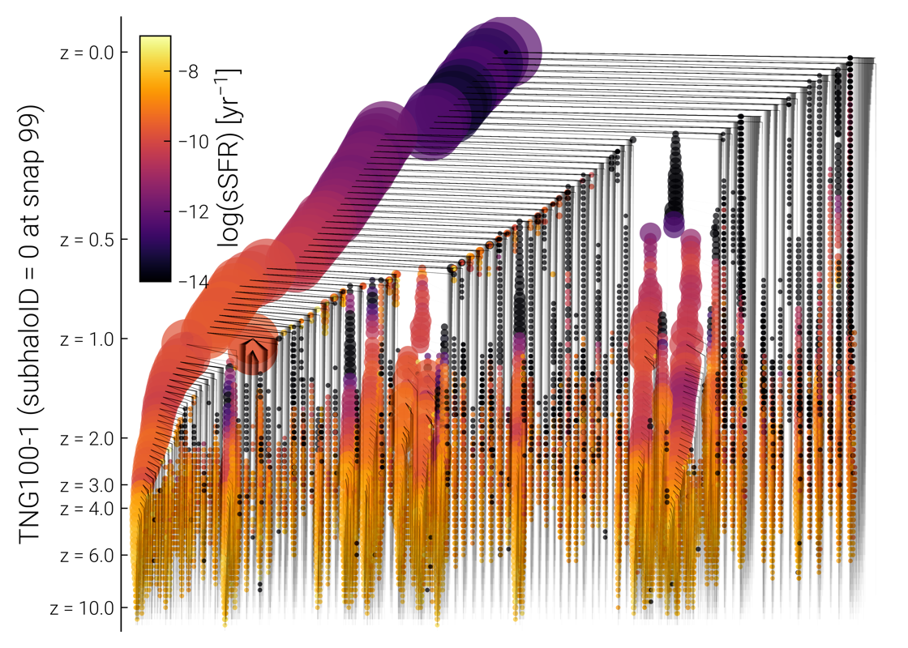
class merger_trees:
TNG_workshop.py
data_specifications.info
# merger trees trace a subhalo through previous snapshots
# contain group catalog fields as a function of snapshot
# can learn more about the trees in Data Specifications
def merger_vis_tool():
Useful for:
Determining history of a subhalo
Change in properties since a given redshift
Visualization tool allows by-eye analysis of merger history
Example visualization >>
Most massive subhalo in TNG100
Size of circle corresponds to subhalo mass
Merger tree visualization: https://www.tng-project.org/api/TNG100-1/snapshots/99/subhalos/0/sublink/tree.png
Notes:
Merger Trees are another type of data available. A subhalo merger tree tracks a galaxy through previous snapshots by following its most massive progenitor. Each subhalo tree will include fields from the group catalogs as a function of redshift. These can be useful for tracking how galaxy properties have evolved with redshift and understanding the history of individual galaxies.
Merger tree visualizations are available through the API. In the example above, colored portions of the URL can be altered to find the subhalo ID (green) from a given snapshot (purple) in a given simulation (yellow/orange). The underlined portion of the URL will bring you to a page that gives the group catalog fields, particle cutout files, and merger tree files (including a visualization of the tree).
The example visualization shows the merger history of the most massive galaxy in TNG100. The most massive progenitor is shown on the left, and the history of galaxies that merged with it are shown to the right. The size of the circles represent the subhalo mass while the color represents the specific SFR.
The merger tree files are organized as dictionaries, with entires each group catalog field. The entries are arrays, which are ordered such that the most recent snapshot is the first entry.

Slide 18
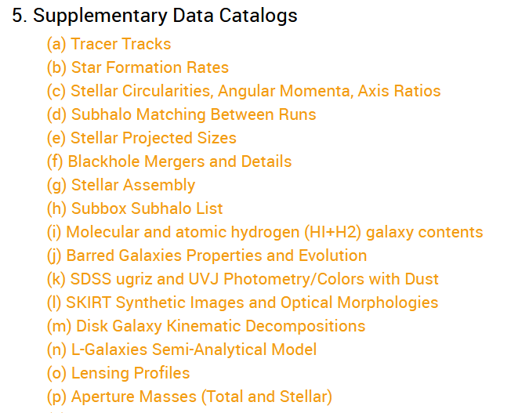
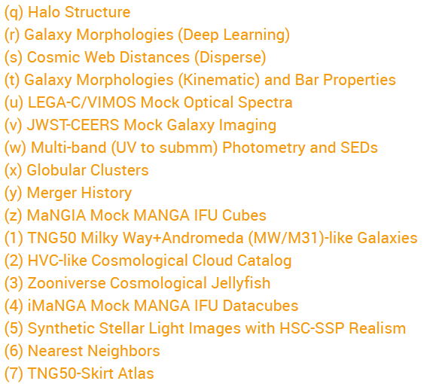
class supplementary_data_catalogs:
TNG_workshop.py
data_specifications.info
# data products derived from simulation data by TNG team and users
# 33 now available and new catalogs added regularly!
Notes:
The final type of data available are the supplementary catalogs. These catalogs were derived by members of the TNG team or other users, and more are added regularly. These catalogs are often only available for a subset of simulations, redshifts, and subhalos.
Starred are a few that may be of particular interest for those studying star formation and comparing TNG results to observations.
Catalog (b), ‘Star Formation Rates’ includes time-averaged star formation rates for subhalos. This catalog computes SFRs based on the initial mass of particles that were formed over the last X Myrs, and these SFRs will be more comparable to those measured in observations than the SFRs given by the group catalogs.
Catalog (e), ‘Stellar Projected Sizes’ include half-light radii in various bands measured from 2D projections. These will be more comparable to half-light radii/ effective radii that are measured in observations than the half-mass and other types of radial measurements in the group catalogs.
Catalog (g), ‘Stellar Assembly’ focuses on the relative contributions of stars formed in-situ and ex-situ to the stellar mass of galaxies.
Catalog (k), ‘SDSS ugriz and UVJ Photometry/Colors with Dust’ derive absolute magnitudes for galaxies that are comparable to those measured with SDSS. They take into account dust obscuration and viewing angle, unlike the absolute magnitudes provided in the group catalogs.
Catalog (l), ‘SKIRT Synthetic Images and Optical Morphologies’ contains synthetic images of galaxies and morphological parameters, including Sersic indices, derived from those images.
Catalog (v), ‘JWST-CEERS Mock Galaxy Imaging’ contain mock images of high-redshift TNG50 galaxies that are comparable to observations made by the NIRCam and MIRI instruments on JWST. The mock images are available in the FITS format.
Catalogs (z) and (4), ‘MaNGIA Mock MANGA IFU Cubes’ and ‘iMaNGA Mock MANGA IFU Datacubes’ contain mock integral field spectroscopy data for 10,000 galaxies in TNG50. The data cubes are meant to emulate integral field unit data from the SDSS MaNGA survey.
A full list and more details about these catalogs are available at: https://www.tng-project.org/data/docs/specifications/#sec5. Be sure to read the associated papers to understand the methodology and follow the citation requests when using these catalogs.

Slide 19
Troubleshooting; {
TNG_workshop.py
data_specifications.info
Problems accessing data with API
< Print URL in get(), check for accuracy, follow in browser. >
Odd outlier(s)
< Check system with Visualize Galaxies and Halos tool or data/vis in browser API >
Other
< Check the FAQ, reach out for help! >
}
Notes:
Here is some general advice for trouble shooting problems when working with TNG data.
If you are having trouble using the API to download data, print the URL you are trying to access, check that it is the URL you are expecting, and follow it in your browser. Reduce the URL to https://www.tng-project.org/api/[SIMULATION_NAME]/snapshots/[SNAPSHOT NUMBER]/[HALOS or SUBHALOS]/[HALO OR SUBHALO_ID], fill in the brackets with the simulation name, snapshot number, halos or subhalos, and the halo/subhalo ID to see the full list of data products available for a given halo/subhalo (see the example on slide 17).
There are cases where certain products are not available for certain halos/subhalos. For example, the progenitors of some subhalos cannot be found, and therefore they do not have merger trees.
Use the Visualize Galaxies and Halos tool on the TNG website to examine strange outliers. Confirm that the parameters you have identified for the halo/subhalo are in agreement with those in the browser API.
Use the Data Specifications page to check your units! Always be careful when the unit contains little h. To convert, e.g., the box length of TNG100, 75 Mpc h⁻¹, to 106.5 Mpc, you divide 75 Mpc h⁻¹ by h = 0.6774 (which is given on the Background & Important Details page).
Check the FAQ and the discussion forum to see if your question has already been asked and answered.

Slide 20
03 {
[Practical Exercises]
TNG_workshop.py
practical_exercises.ipynb
< Your turn! Practice in Jupyter Notebooks >
}
Notes:
In the Github repository is a series of three notebooks that walk through accessing and using TNG data.

Slide 21
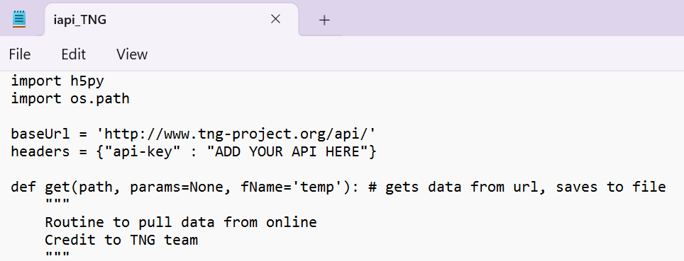
Update your API key!
TNG_workshop.py
practical_exercises.ipynb
Notes:
Included in the Github repository is iapi_TNG.py, which includes various functions for accessing TNG data. You may also want to consider using the API code available at the TNG Github repository: https://github.com/illustristng/. This repository wasn’t available when I first started working with Illustris data as a first-year grad student, so I have my own Python API code that was adapted for TNG from a repository that is no longer available. To download TNG data, you need to request an API key from the TNG website. Once you receive the key, update the headers variable in iapi_TNG.py with your key. If you haven’t received a key, or don’t want to request one, you will not be able to compile all of the code in the first Notebook. However, it may be instructive to read the markdown in Notebook #1 to prepare for the next two notebooks. Notebooks #2 and #3 can be completed without an API key as long as you download the files in backup_data. Some exercises in the first notebook may also be possible to complete using only the backup data.

Slide 22
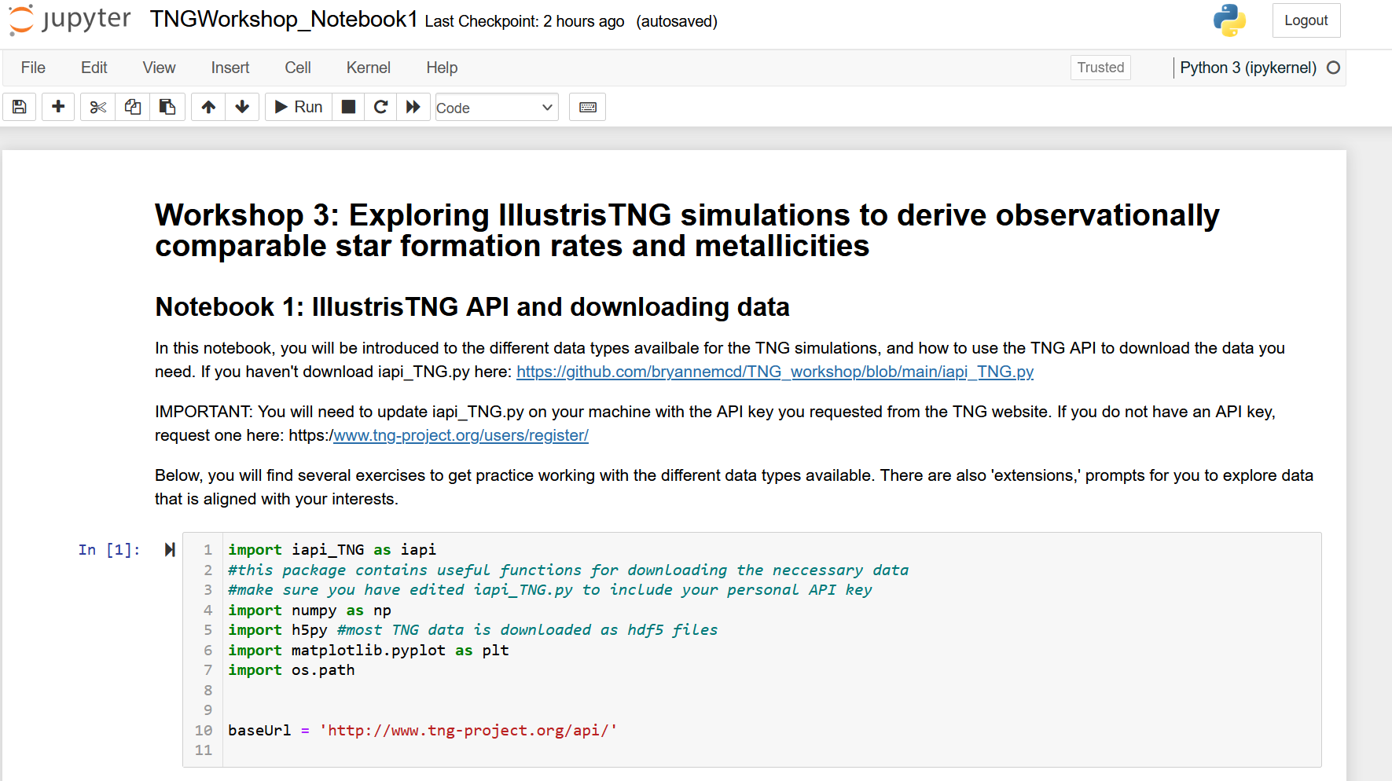
Your turn: Use the TNG API to download simulation data: Notebook 1
TNG_workshop.py
practical_exercises.ipynb
Remember to update iapi_TNG.py with your TNG API key!!!
Didn’t request an API key ahead of time? Follow the link to the github repository in the workshop Slack channel.
Already done with Notebook 1? Move on to either Notebook 2 or 3 OR review other TNG data available that you may want to use
Don’t be afraid to ask the facilitator or your table for help!
Notes:
This notebook walks through downloading data using the TNG API and explores the structure of different data types.

Slide 23
Your turn{
<Notebook 2>
<Notebook 3>
TNG_workshop.py
practical_exercises.ipynb
< Work on Notebook 2 or 3, depending on your interest>
Plot the global SF main sequence
Perform a ‘ridge line’ fit of the SFMS
Investigate impact of choices on SFMS slope
Convert scale factors to lookback times
Compute time-averaged SFRs
Compute luminosity-weighted ages
Done? Work on the other notebook, or brainstorm how you could use TNG for your work.
}
Don’t be afraid to ask the facilitator or your table for help!
Notes:
Notebooks 2 and 3 can be completed independently of each other, but require the files in backup_data/ included in the Github repository.
In Notebook 2, you will practice identifying the star formation main sequence using data from the subhalo group catalogs and a supplementary catalog.
In Notebook 3, you will practice converting scale factors (given in the Merger Trees) to redshifts and lookback times. This can be useful for a variety of exercises, but in this case we use them to obtain luminosity-weighted ages and time-averaged SFRs from particle data.

Slide 24
Thanks; {
TNG_workshop.py
thanks.info
Thank you to the TNG team and Dylan Nelson for the simulation data, API tools, and helpful documentation.
Thanks to Olivia Curtis for improving the notebooks
‘Do you have any questions?’
bnmcd@bu.edu
}

